Slide 1
MALAYSIAN REMOTE SENSING AGENCY Ministry of Science, Technology and Innovation (MOSTI)
THE UTILIZATION OF REMOTE SENSING FOR SUSTAINABLE DEVELOPMENT IN MALAYSIA
Mohammed Hoodh 1627369

Slide 2


MALAYSIAN REMOTE SENSING AGENCY
Formerly known as Malaysian Centre for Remote Sensing (MACRES) - established as an R&D centre in August 1988
Upgraded to a department status with the new name; Malaysian Remote Sensing Agency, on 15 February 2008
The Cabinet on 20 February 2019 had approved the establishment of Malaysian Space Agency (MYSA) through the merging of Malaysian Remote Sensing Agency (MRSA) and National Space Agency (ANGKASA)
The initiative of MYSA is to ensure the development and management of the national space sector in a strategic, organised and comprehensive manner

Slide 3
Location

Slide 4
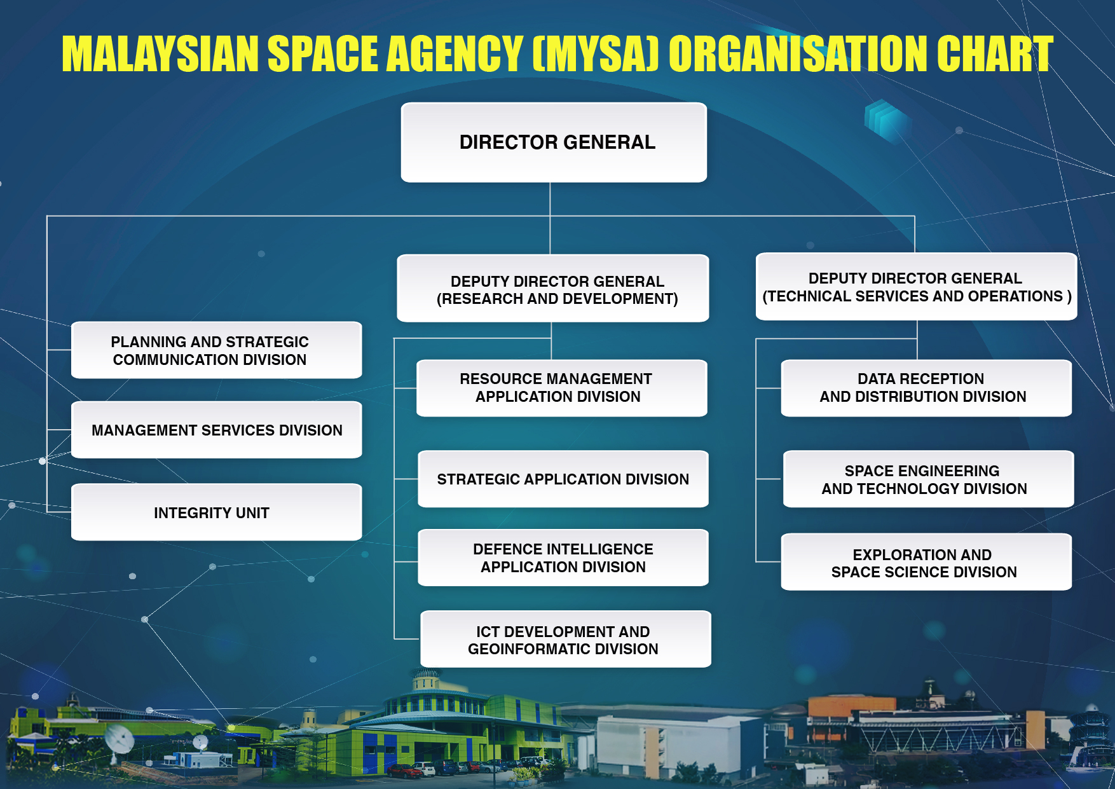

Slide 5
Objective
To develop remote sensing and related technologies applications for their operationalisation in user agencies for management of natural resources, environment and disasters, security, land and infrastructure development of the nation

Slide 6

Main focus
R&D (applications and technology development)
Centralised remote sensing satellite image Provider
Technical advisory and technology promotion

Slide 7
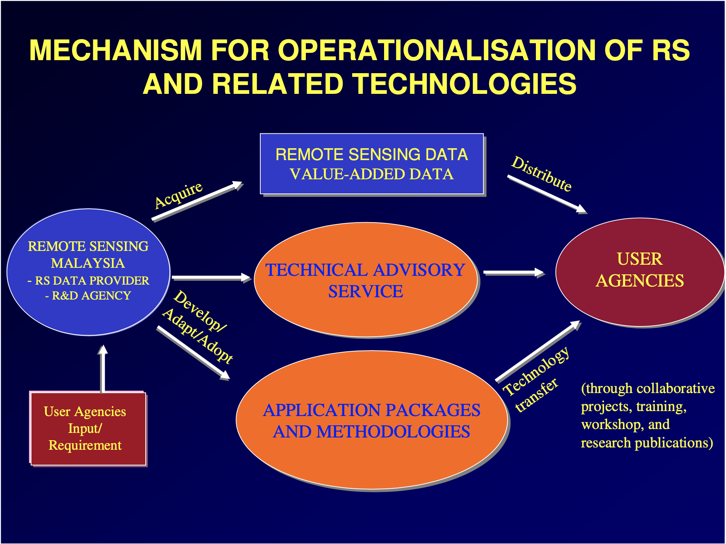

Slide 8
Research and development (R&d)
The Research and Development (R&D) programme of MYSA is formulated to support user agencies in the management of agriculture production, natural resources, environment, disaster, security and land development
The programme also carries out the cabinet directives on the use of remote sensing technology to support implementing agencies in the planning, development and management of national resources. The success of this programme is achieved through active participation by government agencies, institutes of higher learning and private sectors

Slide 9
Data services
One of Remote Sensing Malaysia's mandates is to provide remote sensing satellite images to all users in the country, including RazakSAT satellite data
RSM also responsible to enter into direct negotiations with foreign satellite operators for the procurement of direct reception of satellite images via Ground Receiving Station in Temerloh, Pahang. Acquisition of Radarsat-1, Spot 2, 4 and 5, Modis, OCM and NOAA satellite image satellite is done through this ground station, while Ikonos and QuickBird satellite images are accomplished through foreign ground stations

Slide 10
Technical advisory
Human Capital Development (HCD) programmes has been organised for user agencies. The main objective of the programmes is to increase skilled and trained work force in user agencies in remote sensing and related technologies. The activities include trainings, workshops, seminars, conferences and various customized courses to meet specific users' requirements
The training includes hands-on practices on basic and advanced image processing, satellite data integration, image interpretation and classification

Slide 11
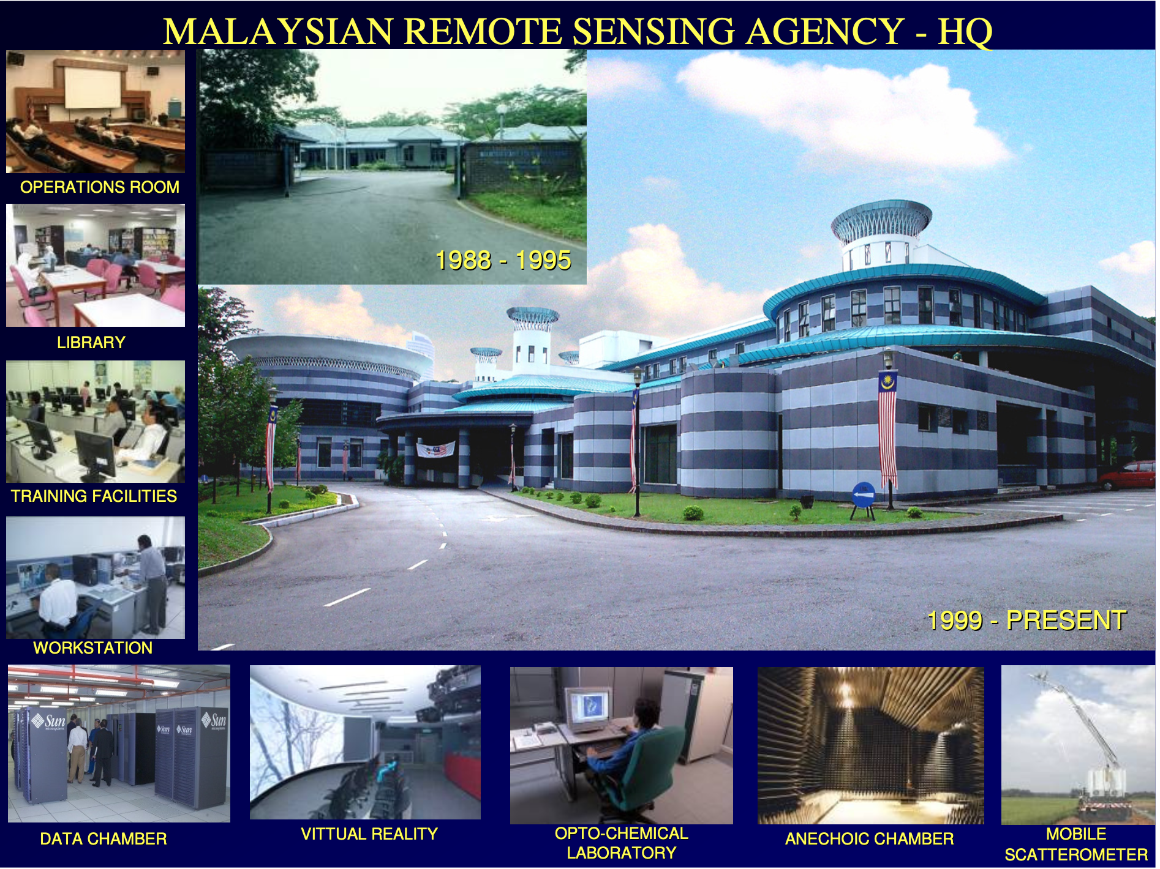

Slide 12
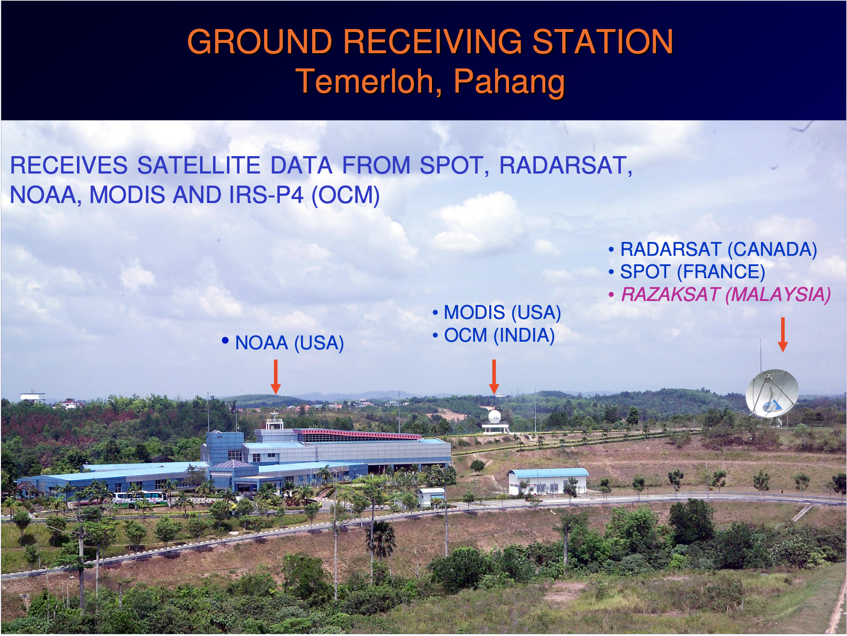

Slide 13
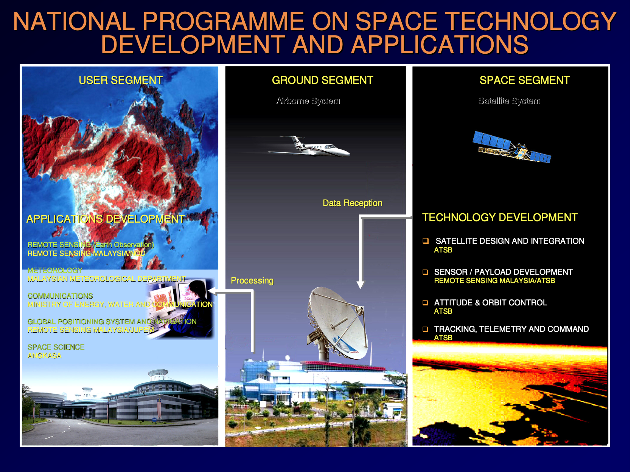

Slide 14
